Slide 1

CROP PREDICTION SYSTEM
Aditi Jain
Akshay Singh
Vaibhav Chauhan

Slide 2
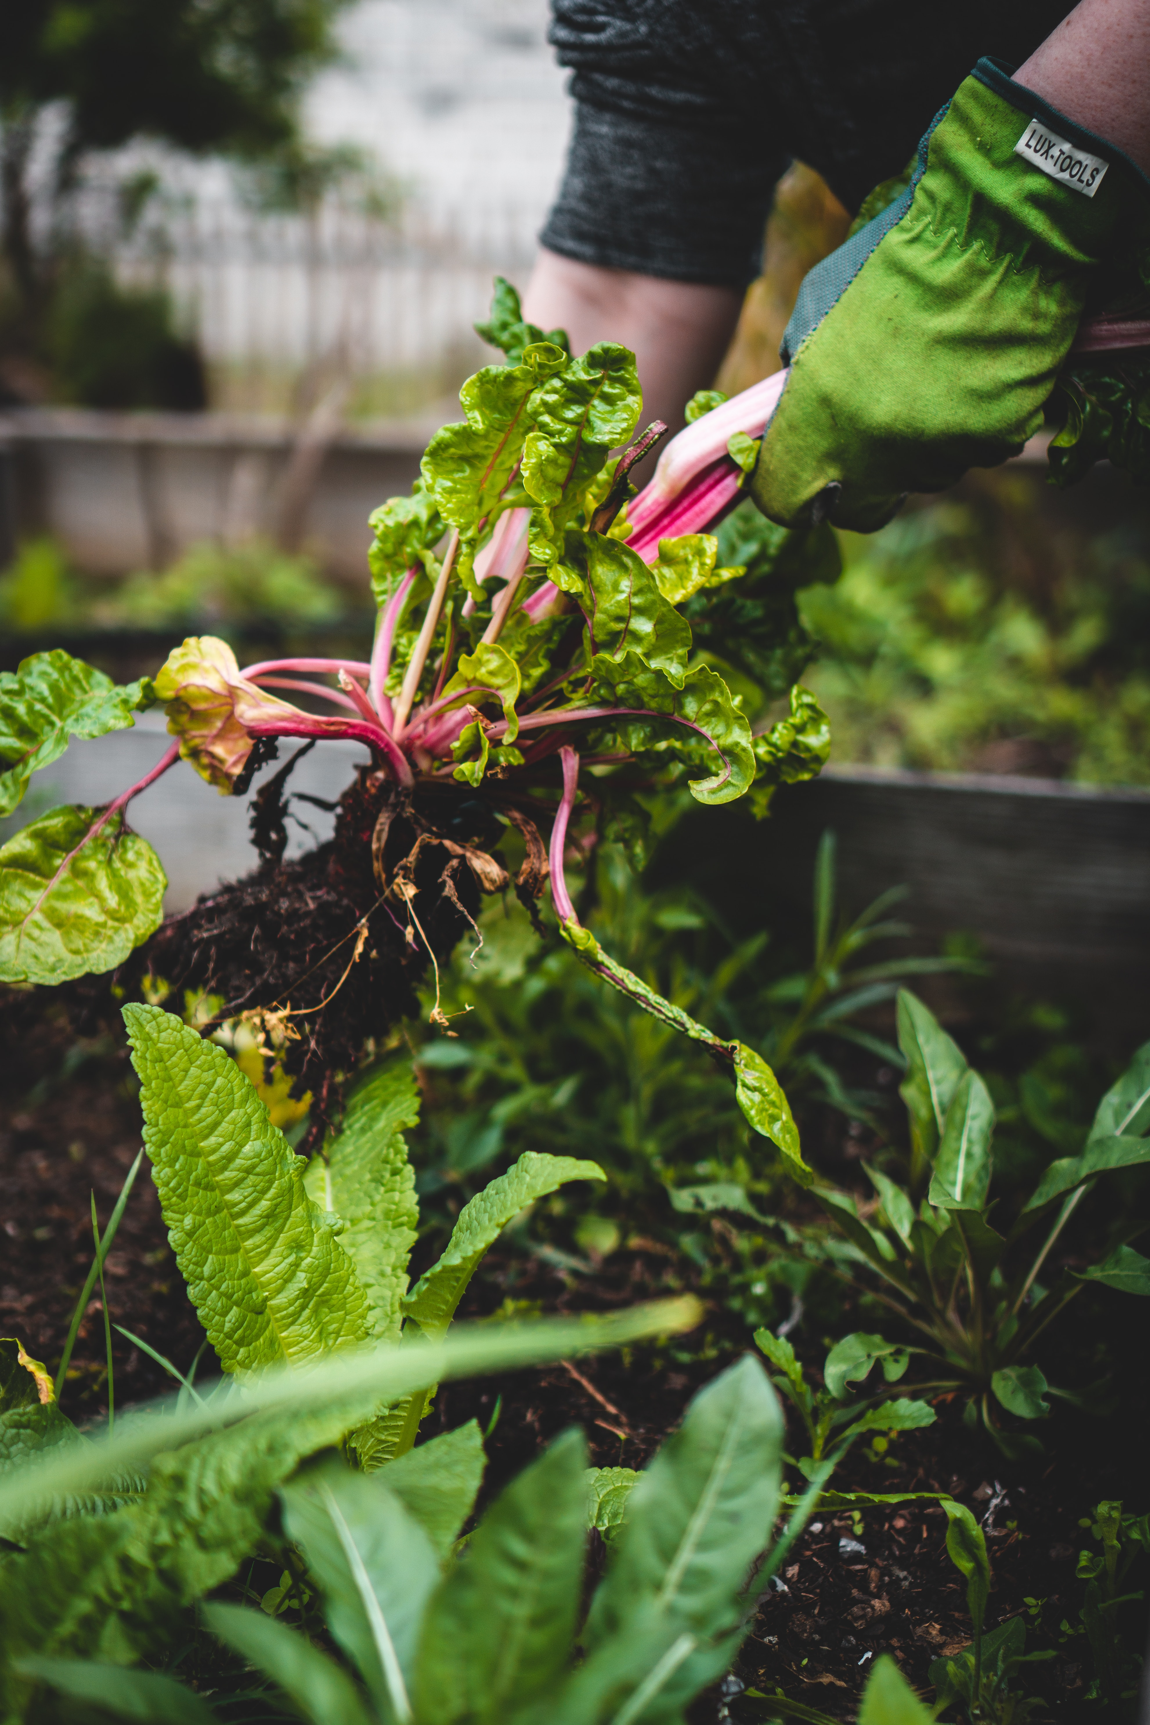
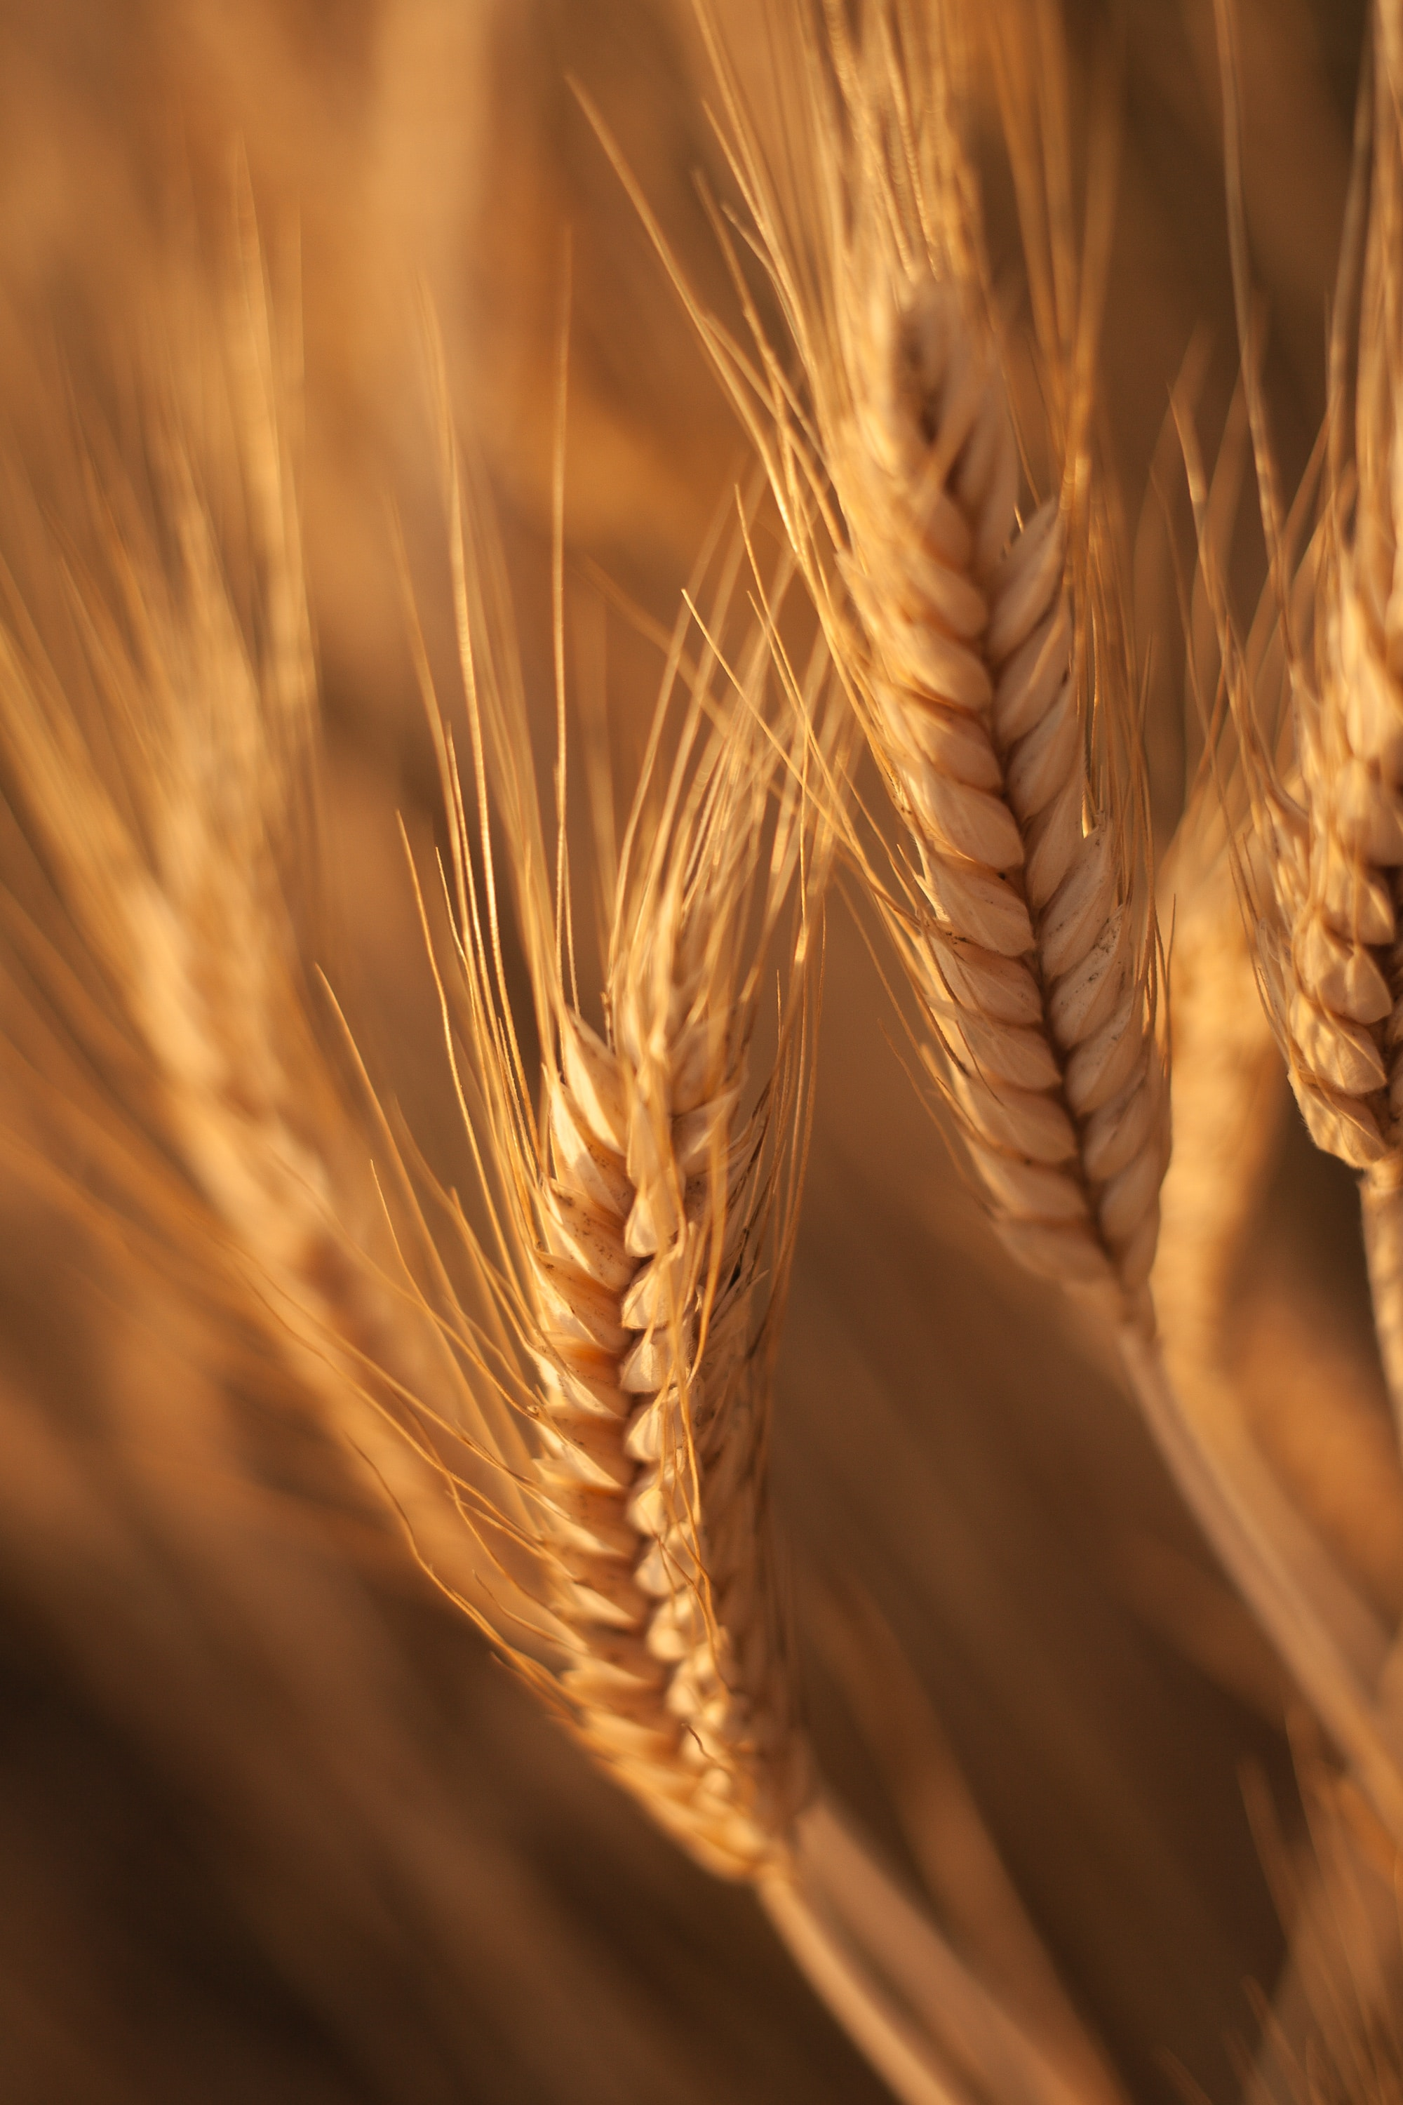
OBJECTIVE
The primary objective of this project is to develop a robust and accurate crop prediction system using machine learning techniques. The system will utilize various environmental factors such as soil pH, soil moisture, NPK (Nitrogen, Phosphorus, Potassium) content, and expected rainfall to predict the most suitable crop for a given region. This system aims to assist farmers in making informed decisions about crop selection, optimizing resource utilization, and improving agricultural yield.

Slide 3
PROPOSED METHODOLOGY
Data Collection: Gather data on soil pH, soil moisture, NPK content, and historical rainfall data from various sources and regions.
Data Preprocessing: Clean and preprocess the data, handling missing values, and standardizing data formats.
Feature Engineering: Create relevant features that represent the environmental conditions accurately.
Machine Learning Model Selection: Experiment with different machine learning algorithms such as decision trees, random forests, and neural networks to determine the best model for crop prediction.
Model Training: Train the selected model using historical data.
User Interface Development: Create a user-friendly web or mobile interface where users can input their location and receive crop recommendations.
Integration: Integrate the trained model with the user interface, enabling real-time predictions.
Reporting and Insights: Develop a reporting module that provides detailed information on the recommended crop offers insights into the decision-making process.
Testing and Validation: Test the system with real-world data and validate its accuracy against known outcomes.
Deployment: Deploy the system for use by farmers in the target regions.

Slide 4
HARDWARE AND SOFTWARE REQUIREMENTS
HARDWARE
software
Server or cloud-based infrastructure for hosting the system.
Database server for storing and managing data.
Programming languages (Python, JavaScript).
Machine learning libraries (scikit-learn, TensorFlow, or PyTorch).
Web development frameworks (Django, Flask, React, or Angular).
Database management system (MySQL, PostgreSQL, or MongoDB).
Geographic Information System (GIS) tools for location-based data.
Data visualization tools (Matplotlib, D3.js).
Web hosting and domain for deployment.

Slide 5
MODULE DESCRIPTION
Data Collection Module: This module collects data from various sources, including soil sensors, weather stations, and historical databases.
Data Preprocessing Module: It handles data cleaning, transformation, and integration to prepare the data for analysis.
Machine Learning Module: This module includes model training, validation, and testing using environmental data and crop yield information.
User Interface Module: A user-friendly interface where farmers can input their location and receive crop recommendations.
Reporting and Insights Module: Generates detailed reports on recommended crops, planting guidelines, and historical data analysis.

Slide 6
FUNCTIONALITIES
Input Data: Users can input their location or select it on a map to obtain crop recommendations.
Crop Prediction: The system predicts the most suitable crop based on environmental factors.
Planting Guidelines: Users receive guidelines on planting, fertilization, and irrigation for the recommended crop.
Historical Data Analysis: Farmers can access historical data and insights to make informed decisions.

Slide 7
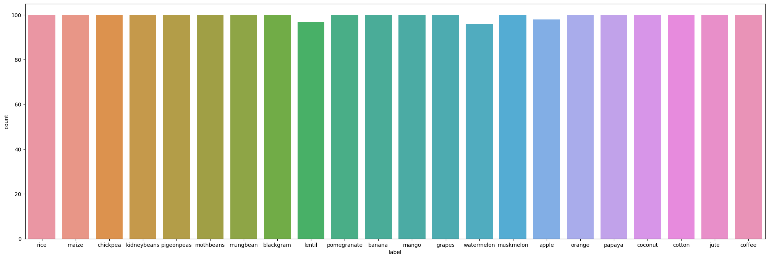
Count plot of crops of each type

Slide 8
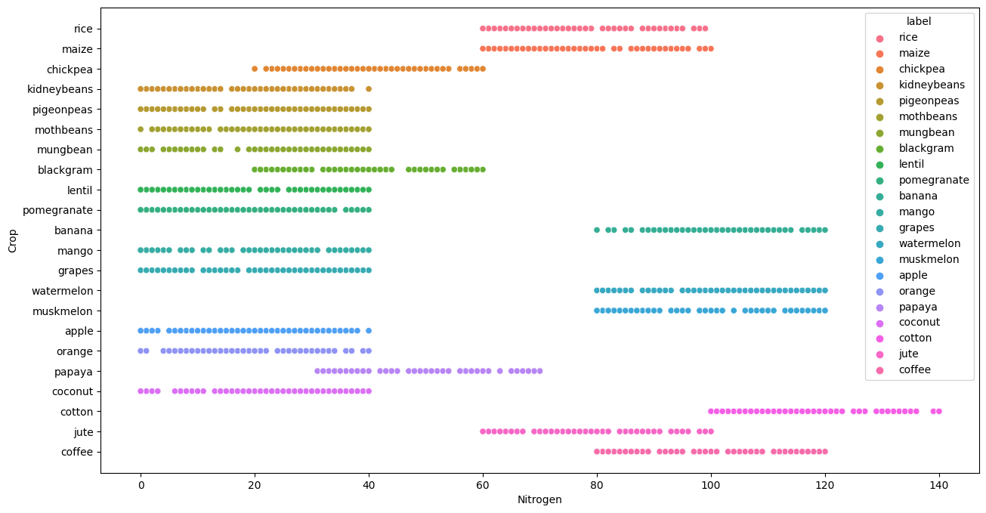
Range of nitrogen for every crop

Slide 9
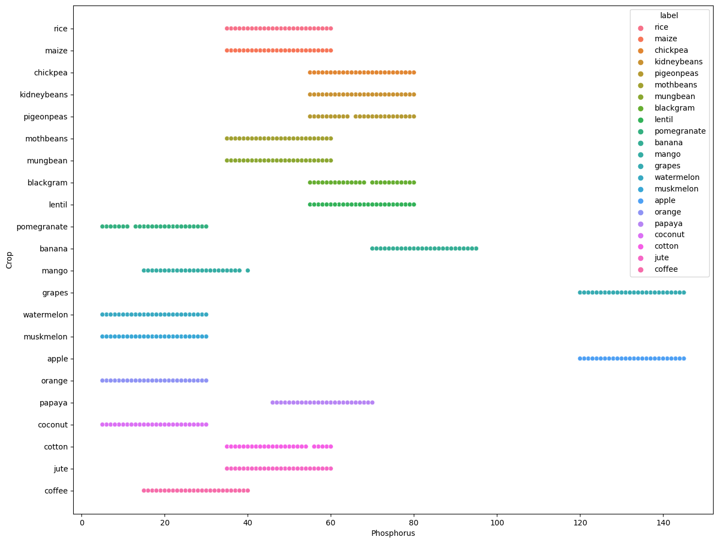
Range of phosphorus for every crop

Slide 10
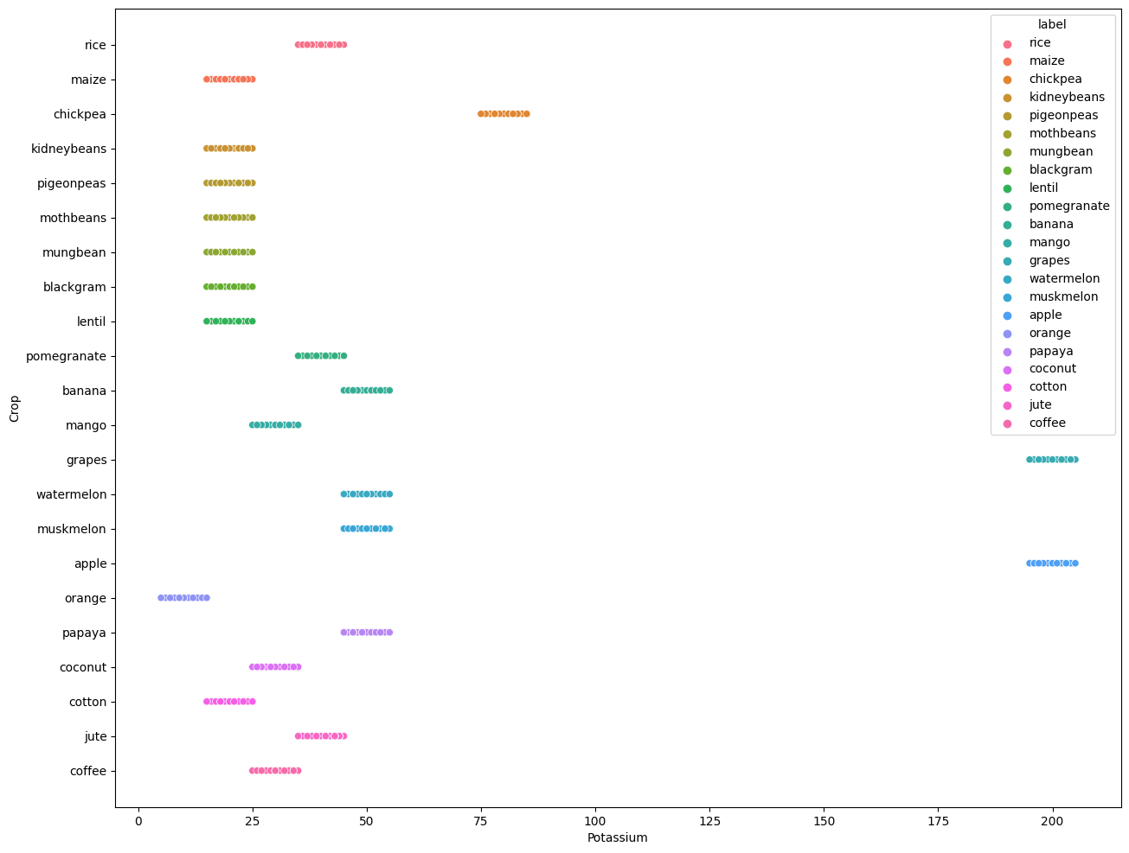
Range of potassium for every crop

Slide 11
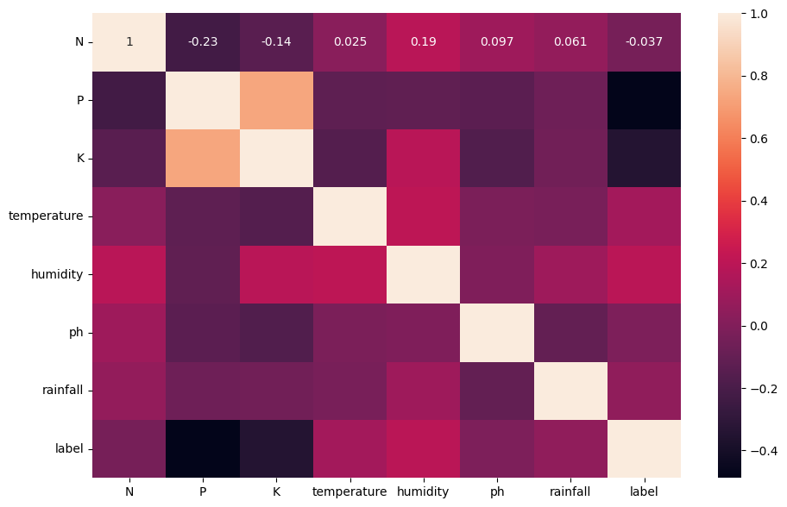
corRelation

Slide 12
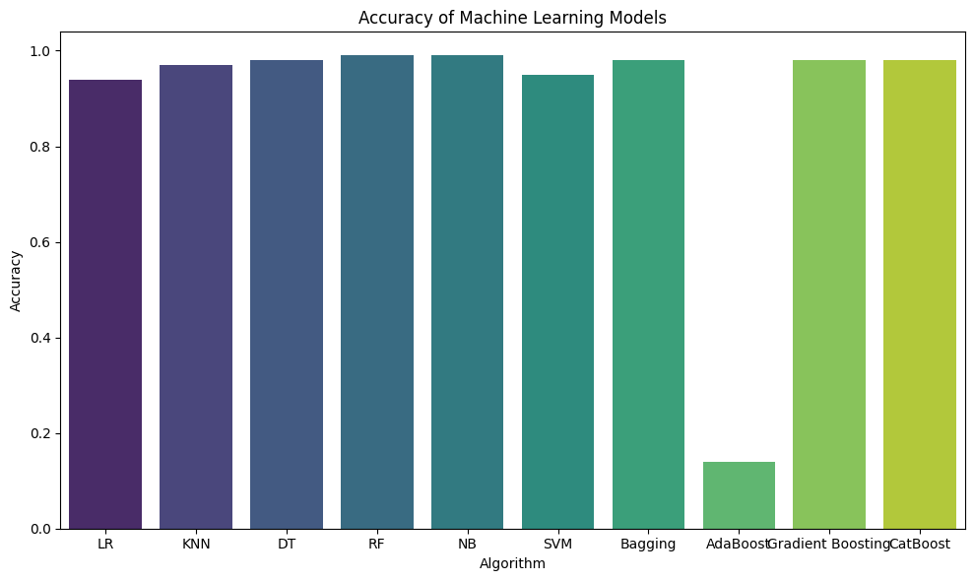
Accuracy of MACHINE learning models

Slide 13
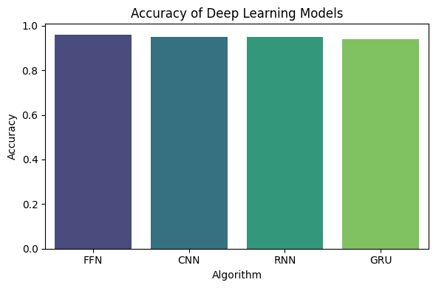
Accuracy of DEEP learning models

Slide 14
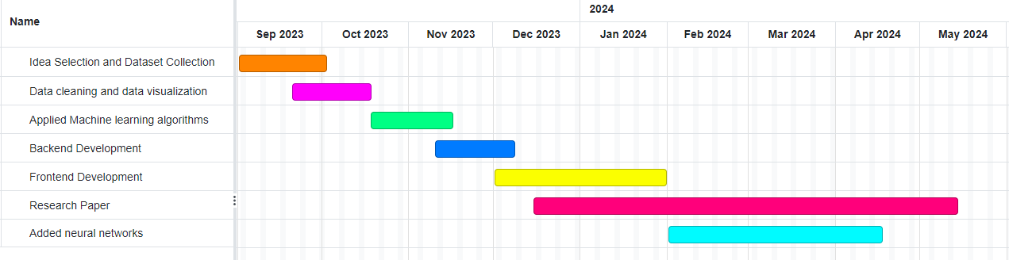
TIMELINE

Slide 15

EXPECTED OUTCOME
Accurate Crop Predictions: A system that provides accurate crop recommendations based on soil conditions, NPK content, and rainfall data.
Increased Agricultural Productivity: Farmers will be able to make informed decisions, potentially leading to increased crop yields.
User-Friendly Interface: An intuitive interface accessible to farmers with minimal technical knowledge.
Data Insights: Detailed reports and historical data analysis to aid decision-making.
Contribution to Agriculture: A valuable tool for sustainable and optimized agriculture practices.

Slide 16


References (IEEE Format)
[1] Smith, J., et al. (2019). Machine Learning Approaches for Crop Yield Prediction: An Overview. IEEE Transactions on Agriculture and Environment, 20(3), 456-465.
[2] Wang, Q., et al. (2018). Soil Analysis and Its Role in Crop Selection: A Review. IEEE Journal of Soil Science, 15(2), 210-223.
[3] Rainfall Prediction Models: A Comparative Study. (2017). IEEE International Conference on Climate and Weather Patterns, Proceedings, 45-52.
[4] Nielsen, M. (2012). Usability Engineering. IEEE Computer Society Press.
[5] Patel, R., et al. (2020). User-Centred Design Principles for Agricultural Decision Support Systems. IEEE Transactions on Human-Computer Interaction, 25(4), 315-328.

Slide 17
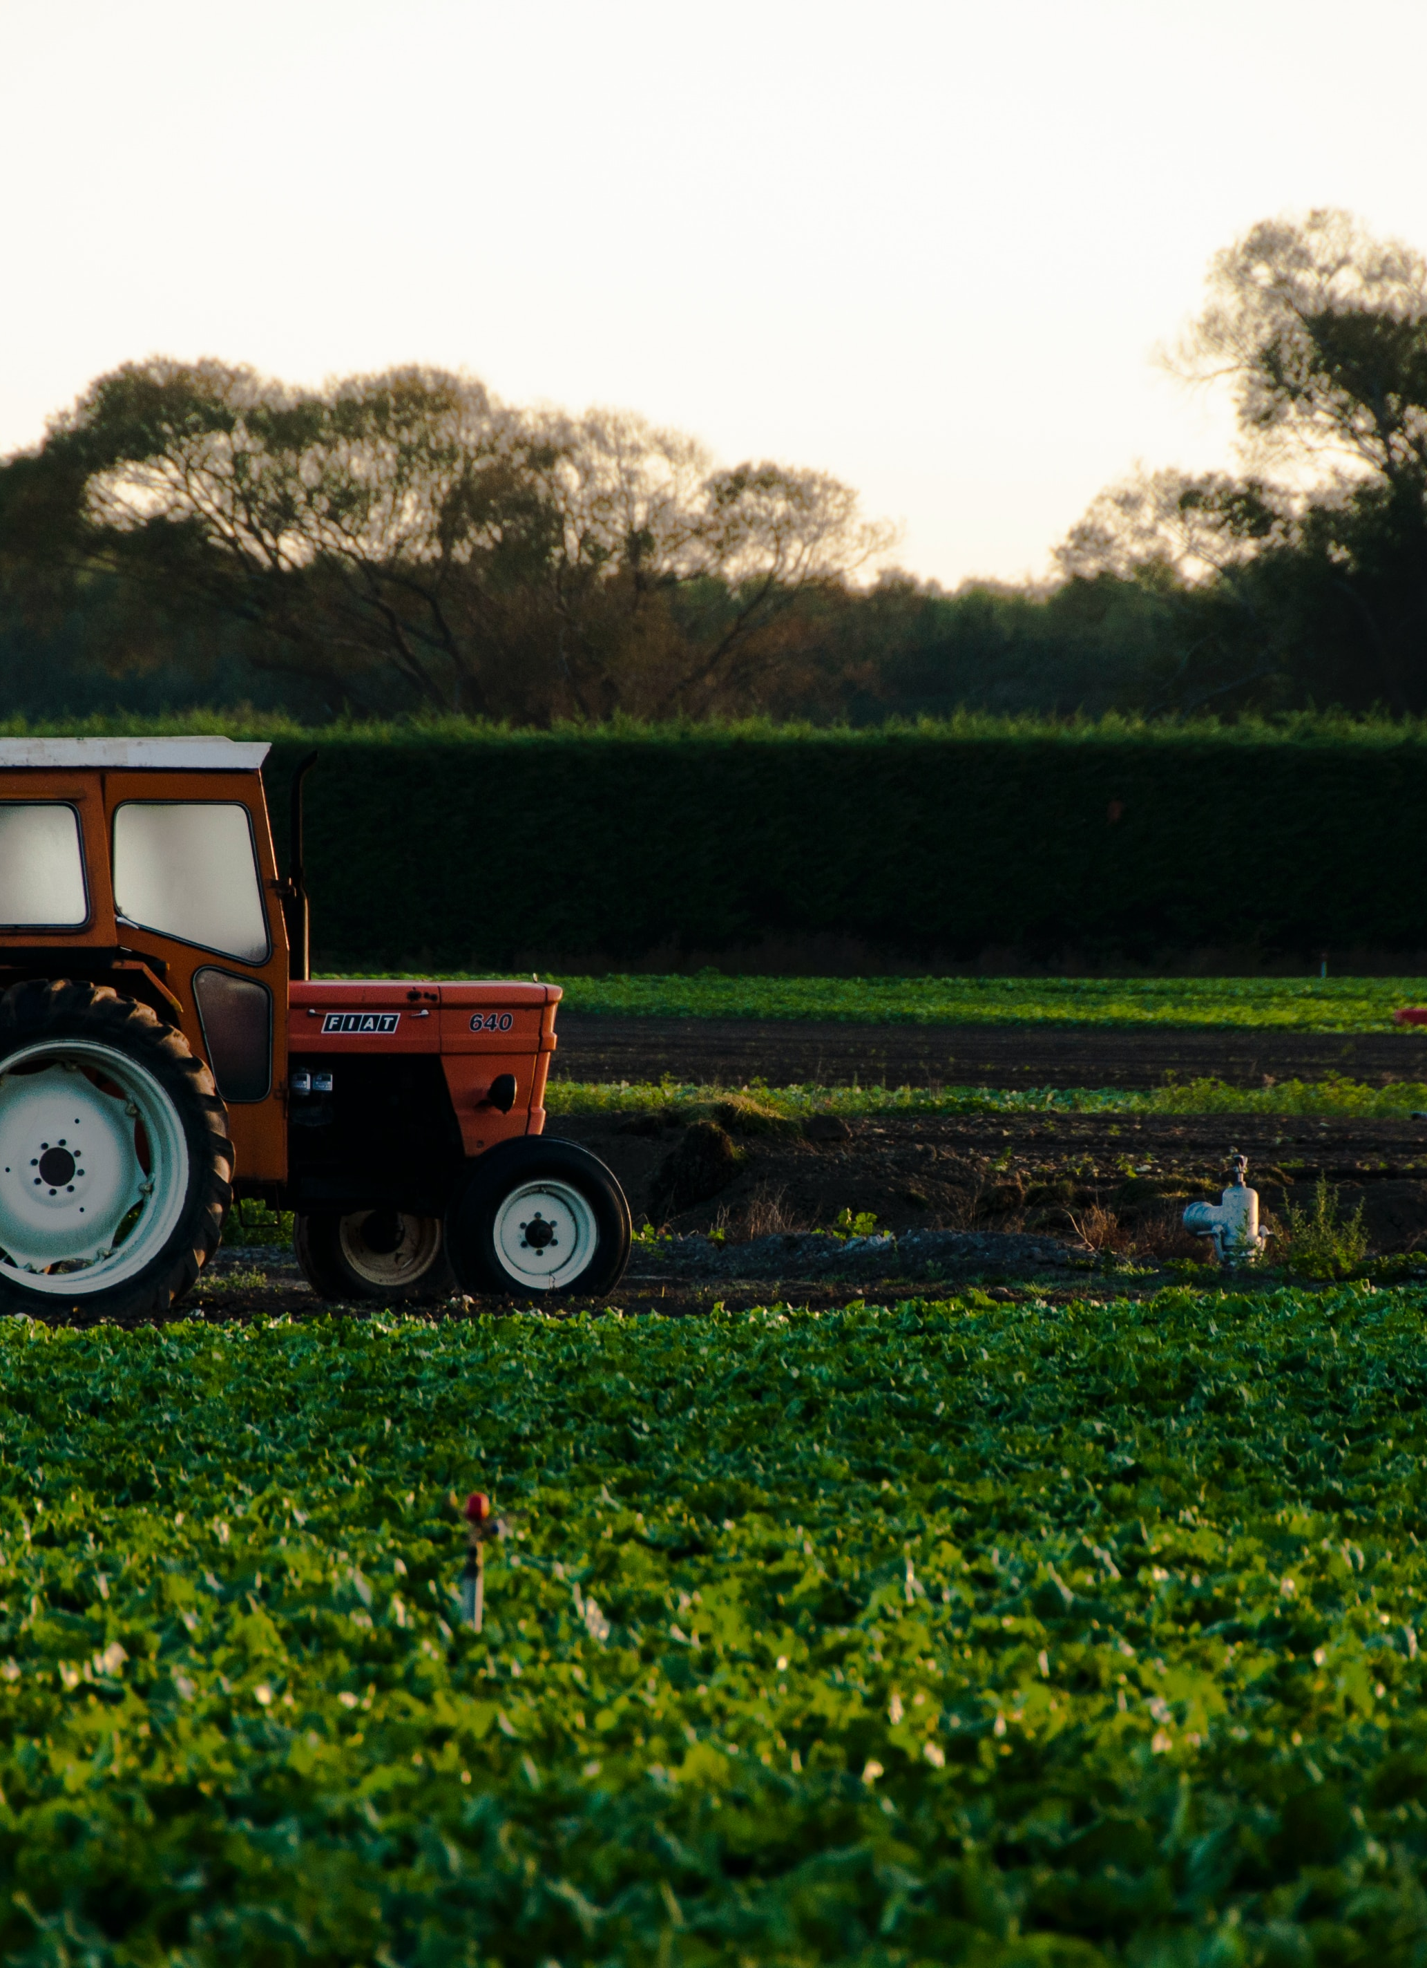
Thank you

